Slide 1
The UNIX System

Slide 2
Introduction
What is an OS and what is it good for?
Where to get Linux
Basic commands
Getting help

Slide 3
What is an Operating System?
UNIX is an Operating System
Software that manages (allocates and de-allocates) system resources in an efficient and secure manner

Slide 4
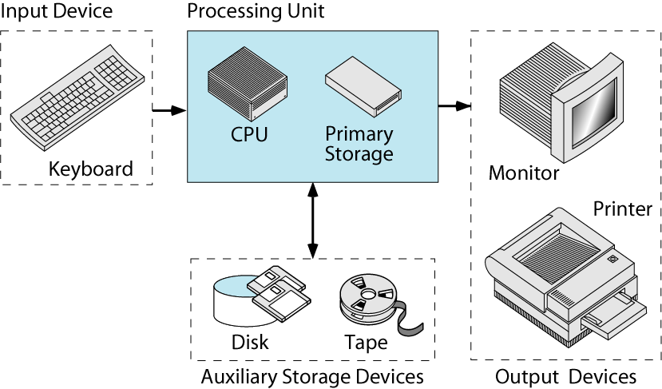
System
Resources
Hardware
Software
System
Software
Application
Software

Slide 5
OBSOLETE TYPES OF OPERATING SYSTEMS
Single-user, single-process operating systems:
allow only one user at a time on the computer system
user can execute/run only one process at a time
Examples: DOS, Windows 3.1
Single-user, multi-process operating systems:
allow a single user to use the computer system
user can run multiple processes at the same time
Example: OS/2

Slide 6
CURRENT OPERATING SYSTEMS
Multi-user, multi-process operating systems:
allow multiple users to use the computer system simultaneously
Each user can run multiple processes at the same time
Examples: UNIX, Windows NT (2000, XP, Vista)

Slide 7
UNIX Operating System
UNIX is a
multi-user, multi-process operating system
UNIX is designed to facilitate programming, text processing and communication

Slide 8
USES OF UNIX
User Support Tools
Text processing (vi, sed, awk)
Productivity applications
Programmer Support Tools
Programming languages & compilers (C, C++, Java)
Shell scripts
Personal software process: version control
Source Code Control System (SCCS)
Revision Control System (RCS)
Unix as server
Web server, mail server, application server

Slide 9
WHERE TO GET LINUX
turing.cs.niu.edu or hopper.cs.niu.edu
secure login via ssh from another Linux machine
or Putty from Windows
Homework must run on these!
Install your own Linux system
Spare machine
Dual boot
Linux on a CD (slow)
Other
Cygwin: Unix utilities on Windows
Windows Services For Unix (for some versions of Windows)
MacOS 10 is Unix under the hood
CSCI 330 - The UNIX System
9
Notes:
CSCI 330 - The UNIX System
NIU - Department of Computer Science
9

Slide 10
History of UNIX
Invented by Ken Thompson at AT&T in 1969
First version written in assembly language
single user system, no network capability
Thompson, Dennis Ritchie, Brian Kernighan
rewrote Unix in C: processor/architecture independent
Unix evolution:
Bell Labs, USL, Novell, SCO
BSD, FreeBSD, Mach, OS X
AIX (IBM), Ultrix, Irix, Solaris (Sun), …
Linux: Linus Torvalds

Slide 11
COMPONENTS OF UNIX

Slide 12
Linux Distributions
Base distributions:
Redhat
Debian
Suse
…
Derived distributions:
Fedora
Ubuntu
…
www.distrowatch.com

Slide 13
UNIX Shell
traditional user interface
= the “command line”
Features:
Interpret and execute commands
Command history and editing
Command scripting
Job control

Slide 14
UNIX Shells
sh
Bourne shell: Steve Bourne, 1978
Almquist shell (ash): BSD sh replacement
Bourne-Again shell (bash): GNU/Linux
csh
C shell, Bill Joy, BSD, 1978
tcsh
Tenex C shell (tcsh): GNU/Linux
others: Korn shell (ksh), Zshell (zsh), …

Slide 15
Command Line Structure
% command [-options] [arguments]
Arguments can be:
1. More information
2. Object identifiers
3. Names of files
Command prompt
Command name
Command modifier; usually one character preceded by + or - sign
UNIX is case sensitive
Must be a space between the command, options and arguments
No space between the plus or minus sign and the option letter
Fields enclosed in [ ] are optional

Slide 16
Command Line Example
% sort list
% sort -f list
% sort -o sorted list
Command
argument
Command name
Command option
Option argument

Slide 17
Correcting Mistakes
Again: UNIX is case sensitive (use lowercase)
Key Pressed | Result
Backspace, Ctrl-h | Back up & erase last character
Ctrl-c | Terminates the current command (watch out for Ctrl-z: suspend command)
Ctrl-s | Stops scrolling of output on screen (Ctrl-q to resume/start scrolling)
Ctrl-w | Delete previous word on command line (from cursor back)
Ctrl-u | Erases/deletes entire command line

Slide 18
CORRECTING MISTAKES WITH EMACS COMMANDS
Certain emacs cmds can be used on the command line
Key Pressed | Result
Cntl-a | Go to beginning of line
Ctrl-e | Go to end of line
Esc-f | Go forward one word
Esc-b | Go back one word
Esc-d | Delete word (from cursor to end of word)
Cntl-d | Delete character at cursor
Cntl-k | Delete from cursor to end of line
CSCI 330 - The UNIX System
18
Notes:
CSCI 330 - The UNIX System
NIU - Department of Computer Science
18

Slide 19
Some Basic Commands
passwd - change password
ls - list files
less - show content of file
logout - logout from system
date - display date and time
who - display who is on the system
clear - clear terminal screen
script - make record of a terminal session
uname -a - print current OS detail (version etc.)
man - find and display system manual pages

Slide 20
Getting Help: System Manual
Section No. | Description
1 | User commands
2 | System calls
3 | C library functions
4 | Special system files
5 | File formats
6 | Games
7 | Miscellaneous features
8 | System administration utilities

Slide 21
RTFM: The man Command
show pages from system manual
Syntax: man [options] [-S section] command-name
% man date
% man -k date
% man crontab
% man -S 5 crontab
Caveats:
Some commands are aliases
Some commands a part of shell

Slide 22
More help: online
Some web sites
www.unixtools.com
www.ugu.com
www.unix-manuals.com
www.unixcities.com
www.tldp.org
www.linux.com
www.linux.org
linux.die.net
Or find your own:
Google command, arguments, error messages

Slide 23
Summary
UNIX is multi-user
multi-process OS
We are using two Linux machines
turing.cs.niu.edu and hopper.cs.niu.edu
Debian distribution

